Slide 1
Lines and Shapes

Slide 2
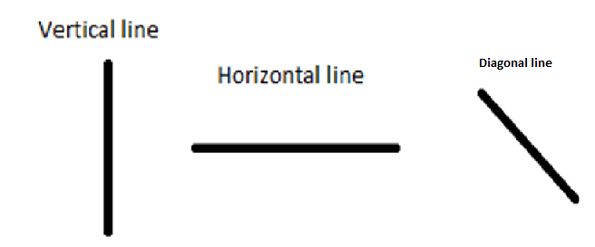

Slide 3
Mark the horizontal lines in green ,vertical lines in red, diagonal lines in blue in the given alphabet.

Slide 4
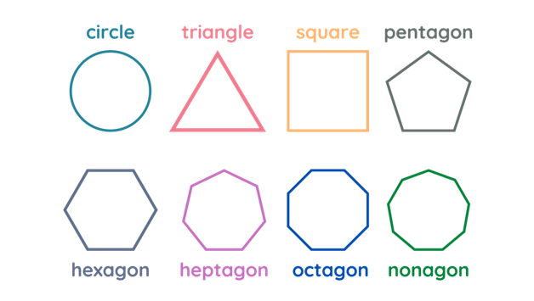
Name | No. of sides | Number of corners
Circle | 0 | 0
Triangle | 3 | 3
Rectangle | 4 | 4
Square | 4 | 4
CONTENT SLIDE

Slide 5
Create your own picture using the given shapes
For Example

Slide 6
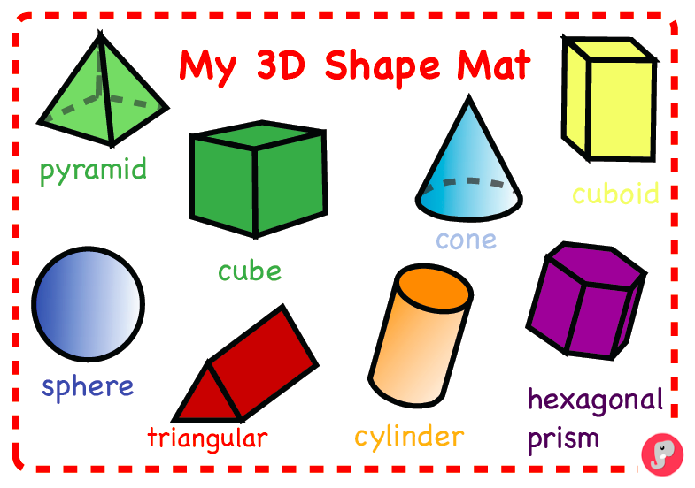
Shape | Flat face | Curved face
Cube | 6 | 0
Cuboid | 6 | 0
Sphere | 0 | 1
Cone | 1 | 1
Cylinder | 2 | 1
CONTENT SLIDE

Slide 7
Thank You

